Slide 1

Hospitality Analytics Project
Group No I : 1. Puja Rathod
2. H Nusrath
3. MD Faisal
4. Shivam Rajput
5. Nitta Archana
6. Aditya Karale
This project, focuses on developing hospitality business insights using dashboards created in Excel, Power BI, and Tableau. The goal is to analyze revenue, occupancy, bookings, and customer behavior to support business development and revenue growth.

Slide 2

Introduction & Problem Statement
Project Goal
Analyze revenue, occupancy, bookings, and customer behavior to drive business development and revenue growth.
Key Challenges
Revenue fluctuations & low occupancy
High cancellation & no-show rates
Difficulty identifying top performers
Management Impact
These challenges hinder data-driven decision-making for hospitality businesses.

Slide 3

Dataset Overview & Objectives
Dataset Details
Key Objectives
Booking details & dates
Track overall revenue & bookings
Revenue realized per booking
Room class & category
Analyze occupancy & capacity utilization
Booking status (Checked-out, Cancelled, No-show)
Identify weekday vs. weekend performance
City & hotel information
Evaluate city, hotel, & room-class contribution
This data enables trend, performance, and behavioral analysis.
Support business development strategies

Slide 4



Tools & KPIs
Excel
Power BI
Tableau
Data cleaning, pivot tables, KPI summaries.
Interactive dashboards, slicers, KPI cards.
Advanced visual analysis, trend storytelling.
Key Performance Indicators (KPIs)
1
Total Revenue
2
Total Bookings
3
Occupancy Rate
4
Cancellation Rate
5
Utilized Capacity

Slide 5

Revenue & Occupancy Insights
Revenue Analysis
Mainly driven by Elite & Premium rooms.
Concentrated in a few key cities.
Insight: Business heavily depends on limited segments.
Occupancy Analysis
Overall occupancy is moderate.
Weekday occupancy higher than weekends.
Certain hotels have unused capacity.
Insight: Revenue can be increased without adding new rooms.

Slide 6
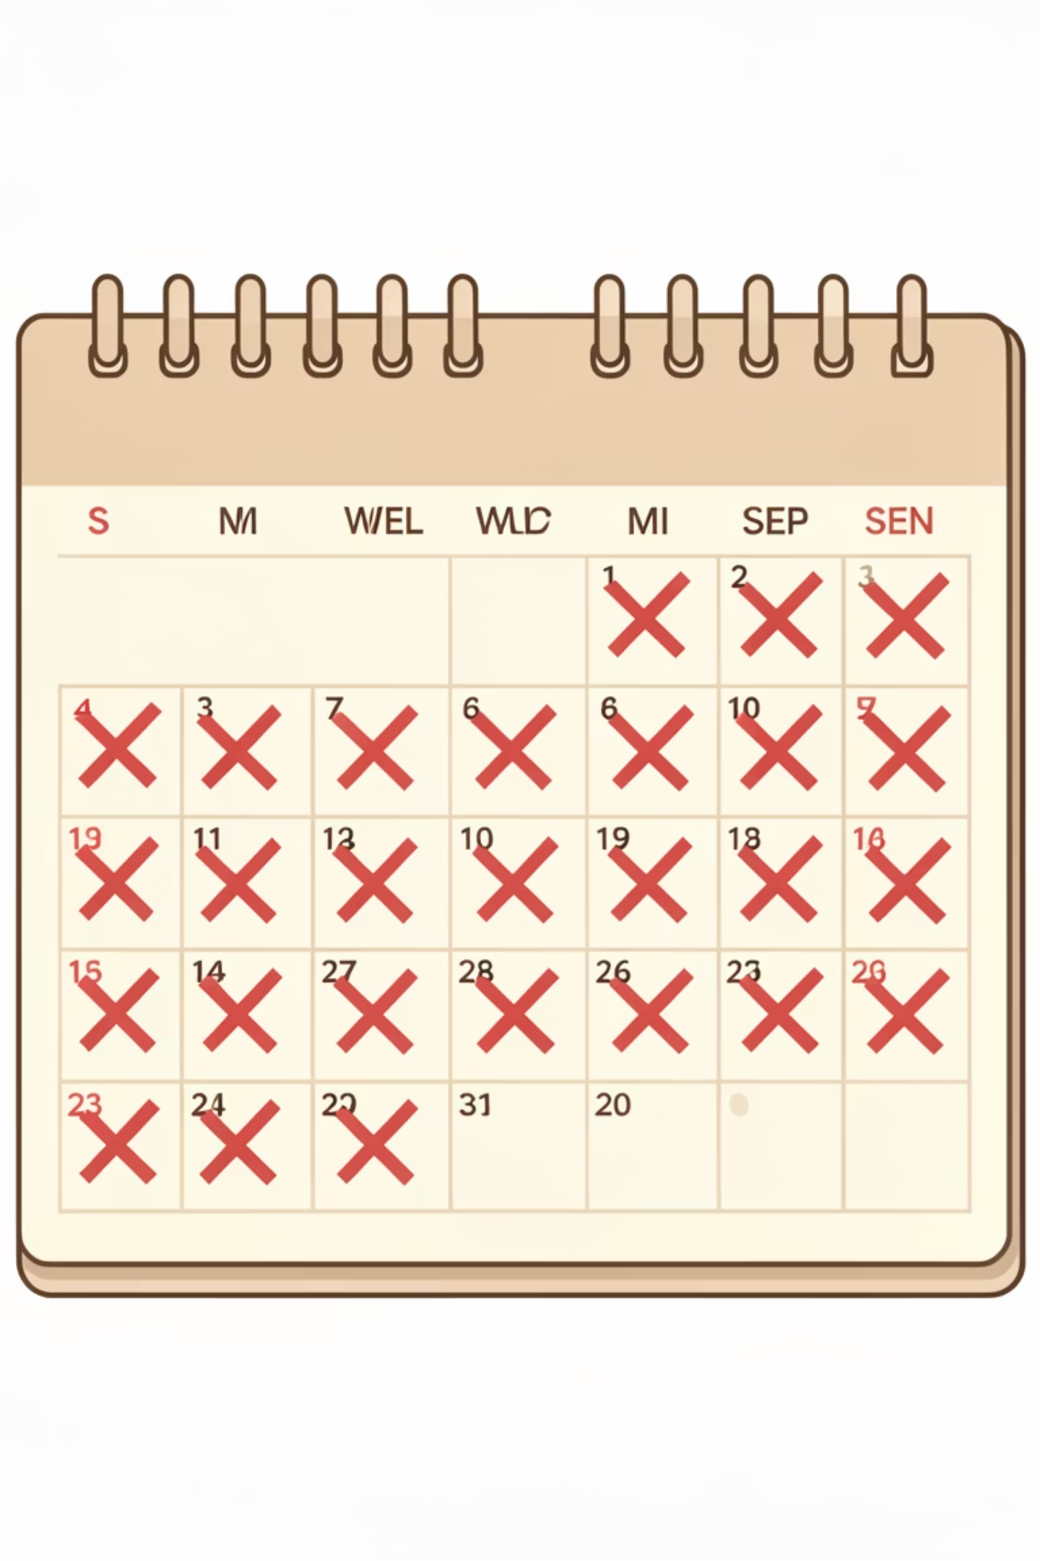
Booking & Capacity Insights
Cancellation Rate
Total Booking Analysis
Significant percentage of bookings are cancelled or no-show, directly impacting realized revenue.
High booking volume doesn't always mean high revenue due to cancellations.
Insight: Conversion from booking to check-out is critical.
Insight: Cancellations represent revenue leakage.
Utilized Capacity
Shows how much available inventory is actually used; low utilization observed during weekends.
Insight: Better pricing and promotions can improve utilization.

Slide 7

Performance by Day & Location
Weekday vs. Weekend
Weekdays generate higher revenue and bookings.
Weekends show lower occupancy and utilization.
Opportunity: Introduce weekend-specific offers.
Revenue by State & Hotel
Certain states and hotels contribute maximum revenue.
Other locations underperform.
Insight: Need location-specific strategies.

Slide 8

Key Insights & Business Problems
Key Insights
Business Problems Identified
Few hotels drive most revenue.
High cancellation & no-show rates.
Occupancy & revenue not always correlated.
Low weekend utilization.
Seasonal demand impacts bookings & revenue.
Uneven city-level performance.
Cancellations affect realized revenue significantly.
Seasonal demand fluctuations.

Slide 9





Opportunities & Recommendations
Dynamic Pricing
Implement for weekends.
Targeted Promotions
For low-performing cities.
Loyalty Programs
To reduce cancellations.
Upselling
Premium room strategies.
Recommendations
Encourage advance payments.
Improve marketing for underutilized hotels.
Use dashboards for continuous monitoring.

Slide 10
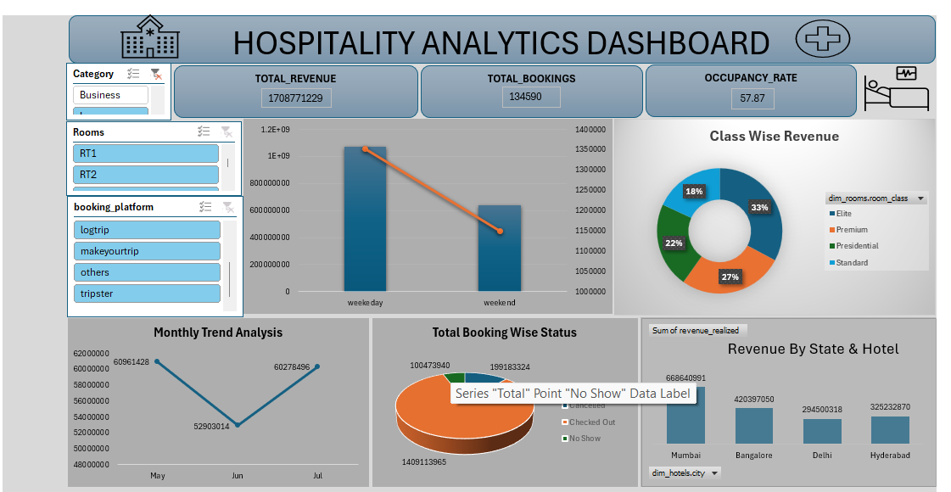

Slide 11
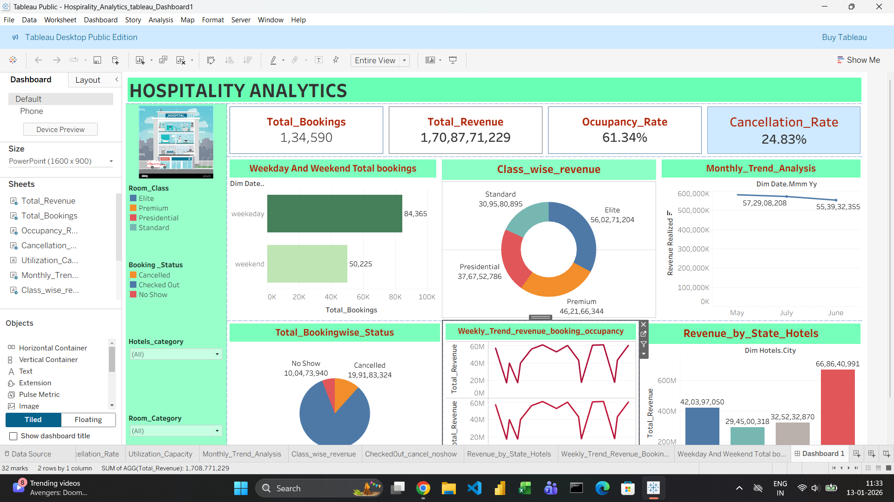

Slide 12
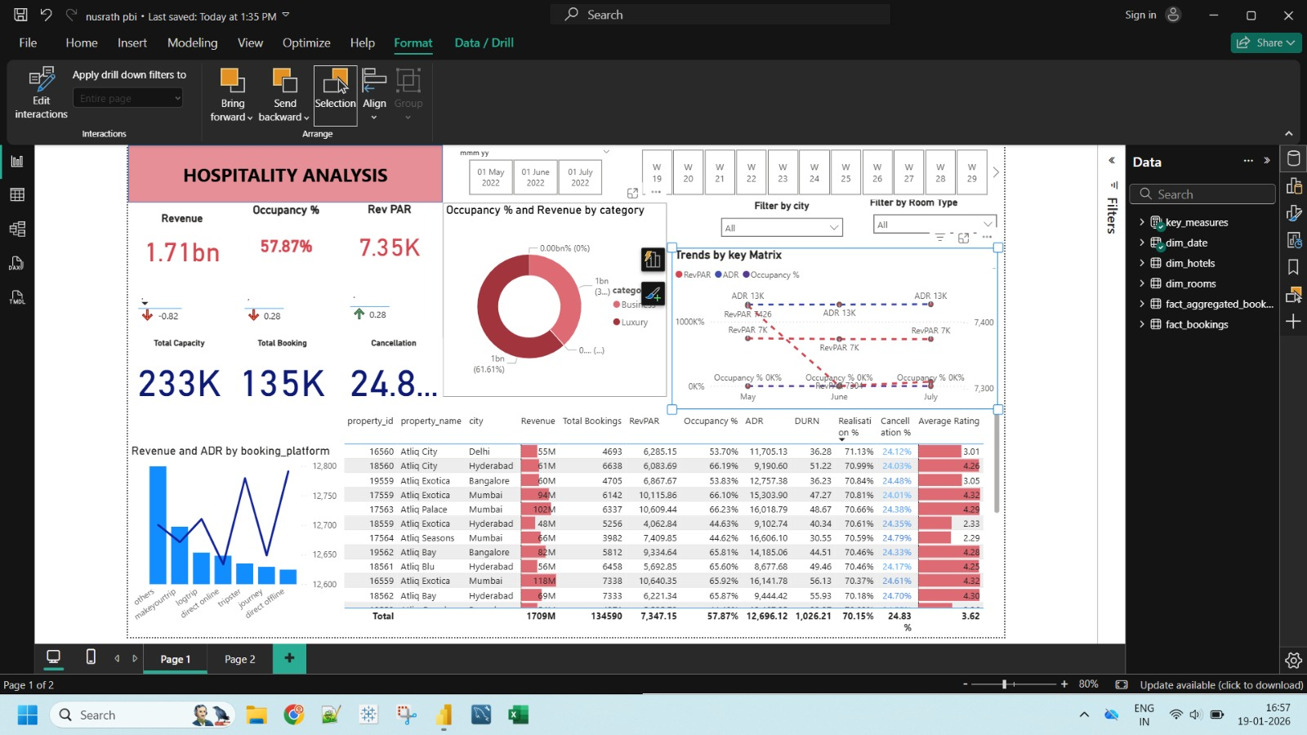

Slide 13
AGENDA
Project progress: All dashboards completed successfully
Team updates: Excel, Power BI, Tableau modules
Challenges: Data cleaning, KPI alignment
Solutions: Standardized KPIs, structured data model
Next steps: Forecasting and deeper insights

Slide 14

Conclusion & Next Steps
This project demonstrates how Power BI, Tableau, and Excel dashboards can convert data into actionable business insights.
The Hospitality Analytics dashboard provides a powerful, data-driven foundation for strategic decision-making. By leveraging KPI insights, understanding demand patterns, and acting on identified opportunities, the business can significantly improve revenue performance, optimize occupancy, and strengthen its competitive position. Continuous monitoring and advanced analytics will be key to sustained growth.
Thank You

